Slide 1
Tweet Sentiment Analysis

Slide 2
The Big Picture
Problem
Detect the sentiment of a given tweet using machine learning model.
Performance score metrics
Recall, Precision, F1 score

Slide 3
Exploration – the data attributes
Airline sentiment
The label, including 3 classes (Positive, negative and Neutral). Will be used for multiclass classification of the sentiment.
Features will be used
For this assignment i’m going to use (name, text or “the tweet”, user timezone) as machine learning features to predict the sentiment.
Features may be used later to enhance the accuracy
Add (tweet coordinates and tweet created date) to the features, which should enhance the prediction accuracy.

Slide 4
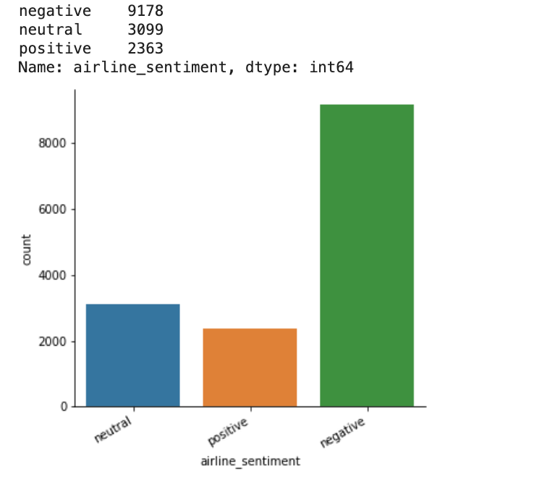
Exploration – Insights
Most of sentiment classes are negative.
Most of tweets come from US & Canada.
Most of tweets come from Boston.

Slide 5
Data Cleansing & Pre-processing
Remove duplicates
I removed the duplicates tweets text.
Null values
I found some null values in the location and timezone fields, i handled them by fill it with ‘None’ value.
User Handles (@user)
I removed all @user handles from all tweets text, which will not make difference in the model training.
Clean the text
I removed the Punctuations, Numbers, and Special Characters.
Short words
I removed the short words < 3 characters.

Slide 6
Data Cleansing & Pre-processing 2
Stemming
I used Potter Stemmer to normalize all tweets.
Common words
I used wordcloud to draw the map of most common words in tweets, words such as (Flights, Plane, Thi, Cancel, Seat).

Slide 7
Model Training
I created test set of 20% of the total data.
I used TF-IDF vectorizer to create the features, with L2 normalization, ngram of 1 word and English stop words.
I tried different models and check the accuracy. e.g. SVM, logistic regression, naiive bayes, ...).check next page for results.

Slide 8
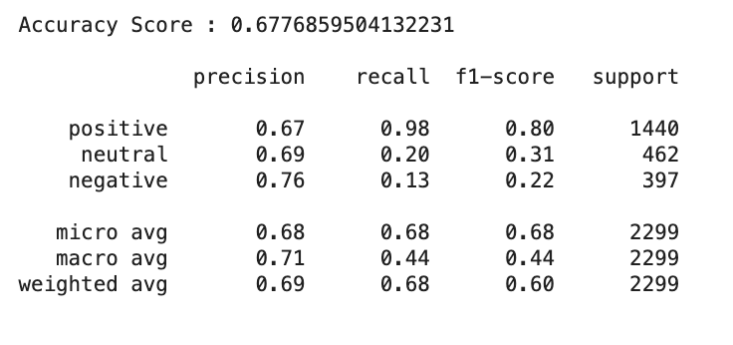
Results
Naiive Bayes

Slide 9
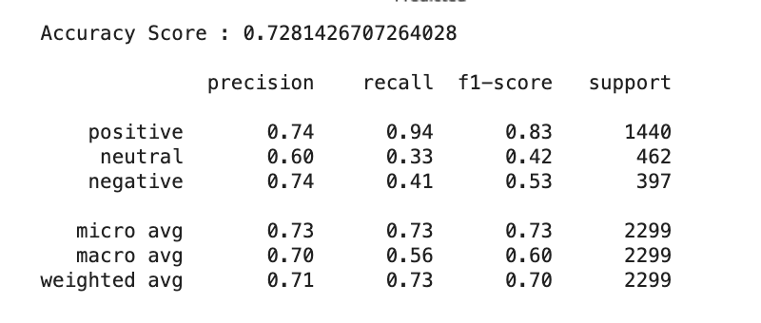
Results
RandomForest

Slide 10
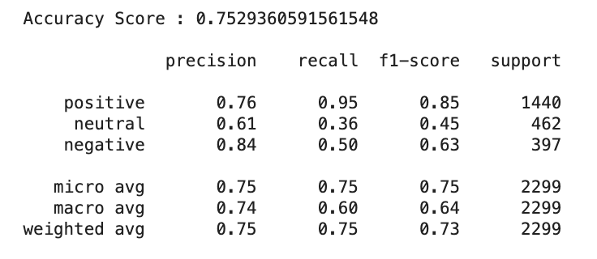
Results
Logistic Regression

Slide 11
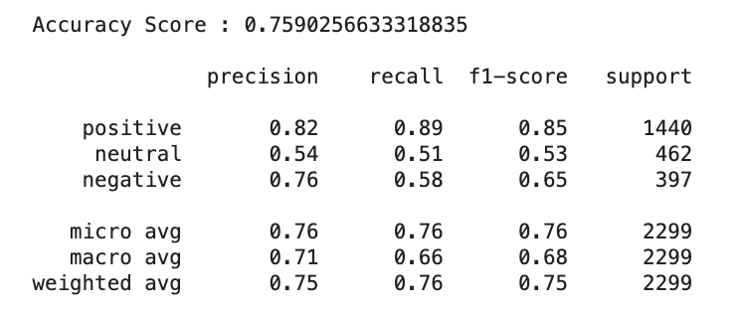
Results
SVM

Slide 12
Thanks
Sameh Amin
24 July 2019

